Slide 1
SOM Hands-On
Exercise 1

Slide 2
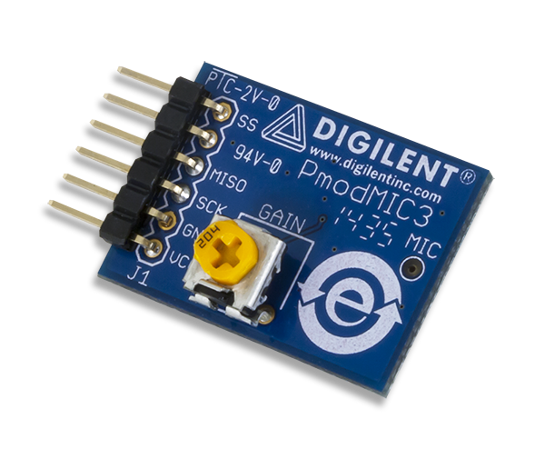
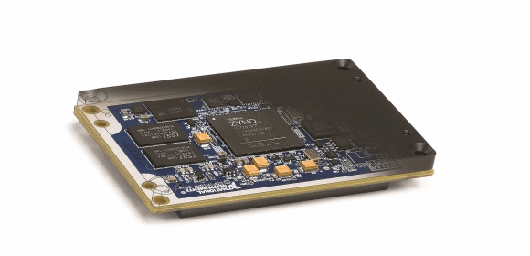
OVERVIEW
In this exercise, you will be reviewing the datasheet of the PmodMIC3 microphone sensor and programming the NI System on Module to acquire audio samples via SPI communication.

Slide 3
PART A - Reviewing the Datasheet
The PmodMIC3 is a MEMS (Microelectromechanical System) microphone that makes us of an onboard ADC to sample analog audio signals. Once the ADC has digitized the analog signal, it transmits the data via a SPI bus to a receiving host device.
In this part, you will determine the required I/O configuration for the SOM to interface with the PmodMIC3, as well as the necessary settings for the SPI communication.

Slide 4
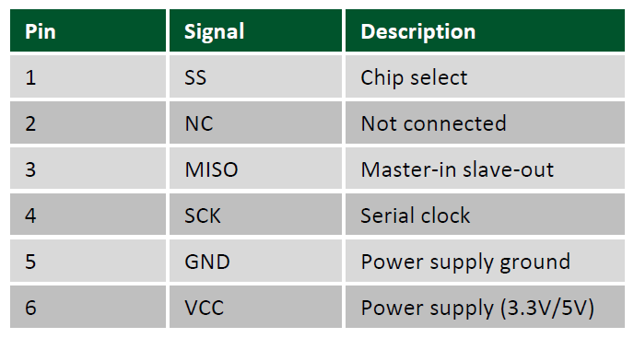
PART A-1 – Physical Connections
To use the Pmod with SOM, the pin configuration of the Pmod must be known before coding the interface.
Open the provided datasheet titled PmodMIC3_RM.pdf.
On page 2, the pinout for the Pmod is listed. Take note which pin corresponds to Signal Select/Chip Select (SS/CS), Serial Clock (SCK/SCLK), and Master-In Slave-Out (MISO). For this application, we do not need to send information to the Pmod, so a MOSI line will not be used.

Slide 5
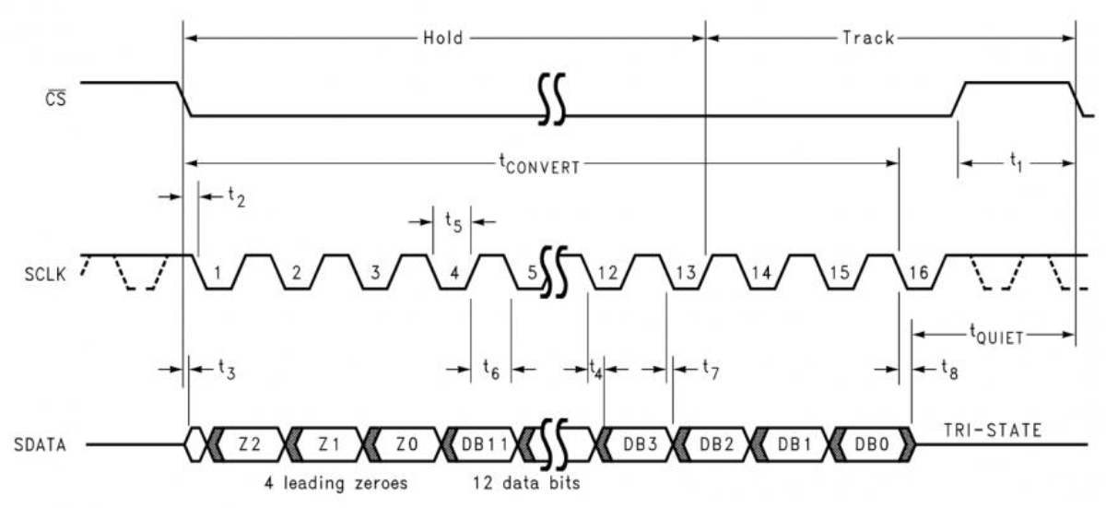
PART A-2 – SPI Configuration
With the pin configuration known, the next important piece of information that is required is how the Pmod intends to transmits samples of data using these pins.
In a typical SPI application, the toggling of the Signal Select (SS/CS) line initiates the transfer of information by informing all devices to transmit and listen on their corresponding MISO and MOSI lines. SPI is a shared clock protocol, meaning the Master device distributes one clock (SCLK) that controls the transfer rate of all communication on the bus. Depending on a device’s setup, a bit of data will be transmitted on the MISO and MOSI lines when there is either a rising or falling edge of SCLK while the SS line is in its active state.
On page 2 of the data sheet, view the provided timing diagram and read the description of the Pmod’s communication procedure.
Important pieces of information to note:
Each bit is shifted out on each falling edge of SCK after CS is pulled low (active).
The ADC is 12-bit, but the transfer uses 16 bits (2 bytes). The first four bits are leading zeroes (unused) and the 12-bit sample fills the remaining 12 bits.
The data is sent with the MSB (most significant bit) first.
For fast transfers (higher SCK frequencies), SCK should remain at a default high state before SS is pulled low.

Slide 6
PART B – SOM in LabVIEW
This part of the exercise will focus on preparing the SOM in a LabVIEW project, writing code for the SOM, and then testing that code to verify functionality.

Slide 7
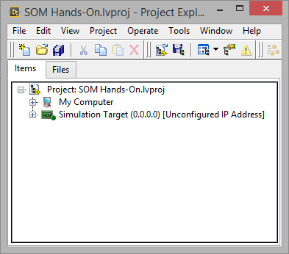
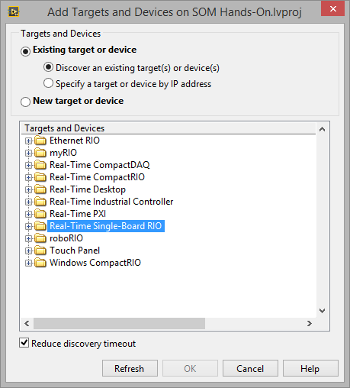
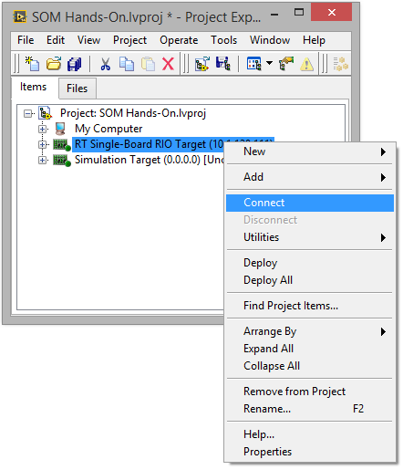
PART B-1 – Configure the SOM
Open the provided LabVIEW project SOM Hands-On.lvproj
The project should already contain My Computer and Simulation Target (more on Simulation Target in a later section).
Add a SOM/sbRIO-9651 to the project. Right-Click on Project: SOM Hands-On.lvproj (one line above My Computer) and select New > Targets and Devices.
In the window that appears, leave the default options selected and expand the Real-Time Single-Board RIO folder to discover the connected SOM. Once it is discovered, choose it and press OK. This will add a SOM target to your project view with a default name of RT Single-Board RIO Target.
Test to make sure you can connect to the target. Right-click on the SOM in the project and select Connect. A deployment window will appear and should mention that the deployment was successful. If it is not successful, alert your instructor.

Slide 8
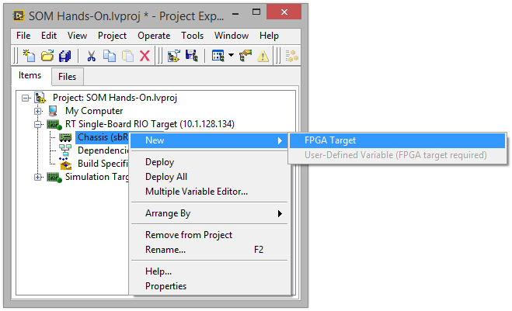
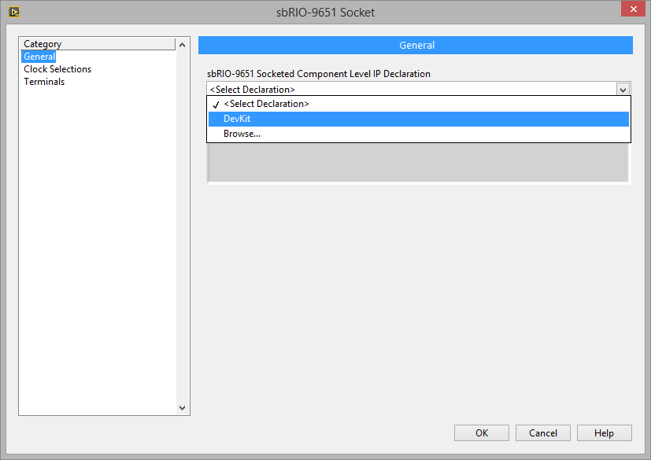
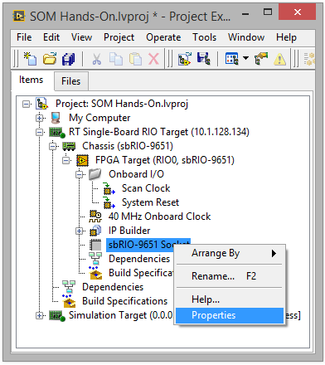
PART B-1 – Configure the SOM
Add an FPGA Target. Expand the SOM target, right-click on Chassis, and then select New > FPGA Target.
Add the SOM’s I/O. Under the FPGA Target, right-click on the sbRIO-9651 Socket and select Properties. In the new window that appears, within the General category, select DevKit from the sbRIO-9651 Socketed Component Level IP Declaration drop-down combo box. Press OK. In the project, you can now see all of the available I/O from the SOM daughter board populate under the Socket item.

Slide 9
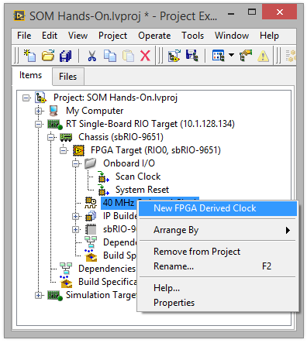
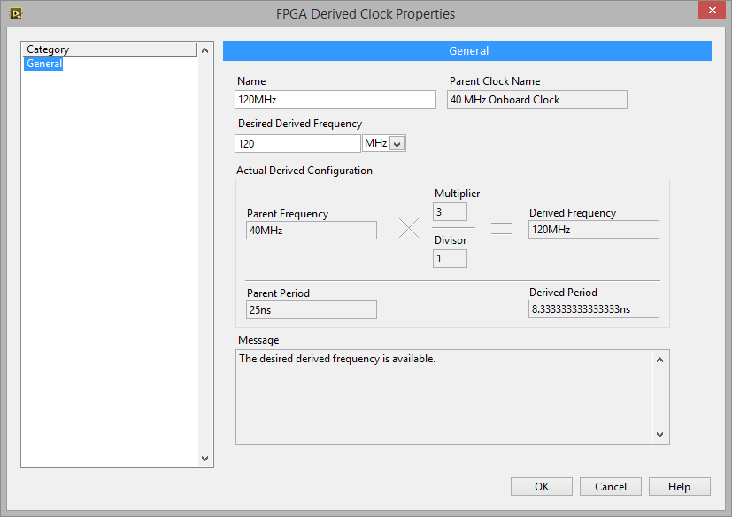
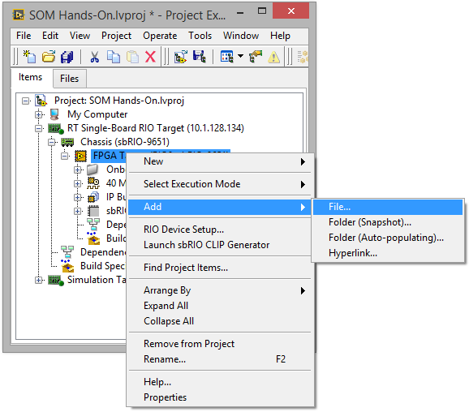
PART B-1 – Configure the SOM
Add a new 120 MHz derived clock. Under the FPGA Target, right-click the 40 MHz Onboard Clock and select New FPGA Derived Clock. In the window that appears, set the desired frequency to 120 MHz, and press OK. This clock will be used later in code to drive logic on the FPGA for the SPI communication.
Add the provided FPGA VIs to the project. Right-click on the FPGA Target and select Add > File, then select the FPGA Main_SPI API.vi and press Add File.

Slide 10
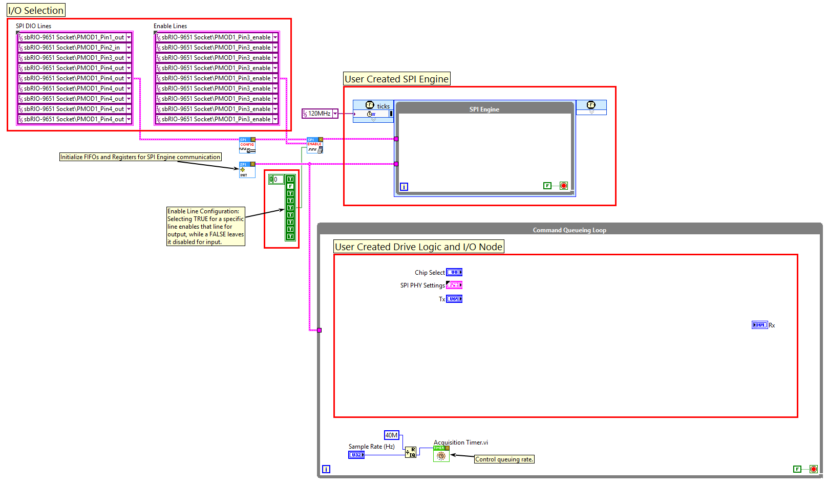
PART B-2 – Modify the SPI Code
Open the block diagram of FPGA Main_SPI API.vi.
View the layout of the code. There are three main parts to be aware of:
First, the initialization code in the left-most section of the block diagram is responsible for designating which hardware I/O lines the SPI API will use to communicate. It also initializes FPGA memory items and FIFOs that the SPI API needs to operate.
Next, the SPI Engine SCTL (single-cycle timed loop) is where the SPI Engine code will be placed. The SPI Engine is responsible for actually controlling, reading, and writing the I/O lines that were selected.
Finally, the Command Queuing Loop is where commands will be prepared and transferred to the SPI Engine for execution.

Slide 11
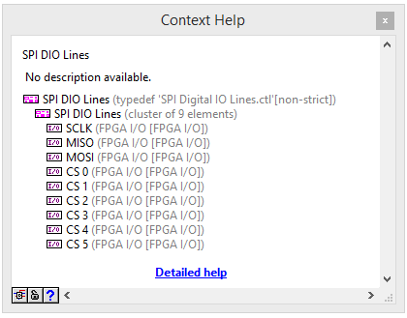
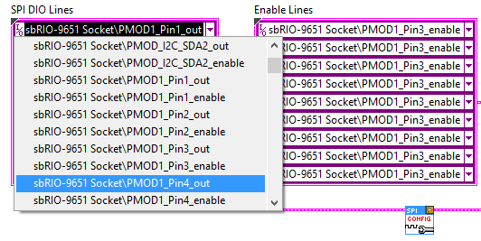
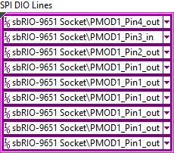
PART B-2 – Modify the SPI Code
Modify the DIO Lines and Enable Lines clusters. In the initialization portion of the code, there are two cluster constants containing I/O references that can be used to select which pins the SOM should use for the SPI communication. In Part A, the pinout of the PmodMIC3 was defined by the Pmod’s datasheet. This pinout will be used to determine the configuration of these I/O constants.
Turn on Context Help (Ctrl+H) and hover over each of the cluster constants. This will provide more information as to which I/O item each of the I/O constants is for. By default, the first I/O item of the DIO Lines cluster is SCLK, followed by MISO, then MOSI, etc.
Press the drop-down arrow for each I/O item and select the resource that corresponds to the pin configuration from the PmodMIC3’s datasheet. For example, if the Pmod is plugged into the PMOD1 connector of the SOM’s daughter board, for SCLK the selected I/O item should be PMOD1_Pin4_out. This is because the PmodMIC3’s datasheet defines the 4th pin as SCLK. Repeat for MISO and CS 0 lines.
There are multiple CS lines available in the SPI API, but for this exercise only one CS line is required. The I/O resource chosen for MOSI and CS 1-5 will not be used.
Ensure the cluster matches the completed cluster to the left.

Slide 12
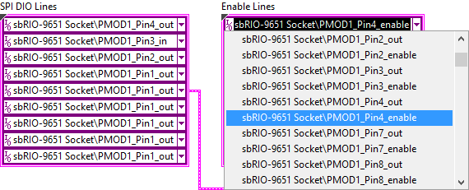
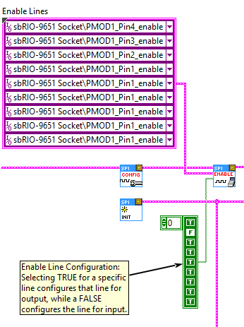
PART B-2 – Modify the SPI Code
Repeat the same I/O selection process for the Enable Lines cluster constant. Ensure the pin numbers are the same as the DIO Lines cluster for each corresponding I/O constant.
The SOM’s DIO lines have to be manually configured for either input or output via an enable line. Writing TRUE to this line configures the DIO channel for output, while a FALSE configures the channel for input.
The Enable SPI Digital Lines VI provides a Boolean array that is used to write either a TRUE or FALSE to each of the I/O items selected in the Enable Lines cluster.
Ensure the Boolean array in your VI matches the configuration shown to the left.
SCLK – TRUE
MISO – FALSE
MOSI – TRUE (not used)
CS 0 – TRUE
CS 1 – TRUE (not used)
CS 2 – TRUE (not used)
CS 3 – TRUE (not used)
CS 4 – TRUE (not used)
CS 5 – TRUE (not used)

Slide 13
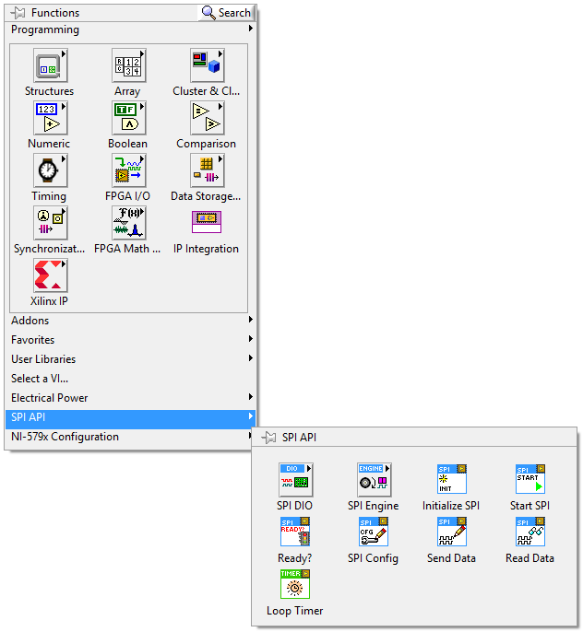
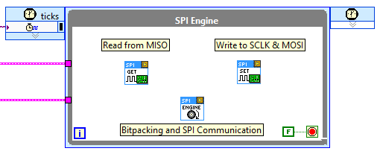
PART B-2 – Modify the SPI Code
Add the VIs for the SPI Engine from the Functions > SPI API > SPI Engine & SPI DIO palettes.
Read SPI Digital Lines – This VI uses the I/O items that were selected for MISO in the DIO Lines cluster to read the current value for that DIO line.
SPI Engine Top – Takes in the current value for MISO and then controls the next logic state for the DIO lines based on what needs to happen with SCLK, CS, and MOSI.
Write SPI Digital Lines – Uses the I/O items that were selected for CS, SCLK, and MOSI in the DIO Lines cluster to write the current logic value for those DIO lines.
Wire the VIs as shown in the image below.

Slide 14
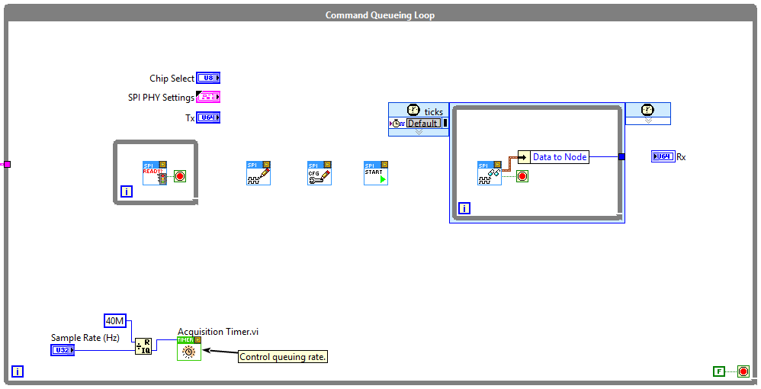
PART B-2 – Modify the SPI Code
Add the VIs for the Command Queuing Loop from the Functions > SPI API palette.
Is SPI Channel Ready? – Checks the SPI Engine command FIFO to ensure there is space to queue a new command. If not, the surrounding loop will retry until the engine is ready.
Set SPI Data for SPI Transaction – Writes a local register with the Tx data intended to be sent.
Set SPI PHY Configuration for SPI Transaction – Writes a local register with the PHY settings and selected Chip Select.
Start Current SPI Transaction – Writes the data from the local registers to the SPI Engine FIFO for transmitting.
Read SPI Response for SPI Transaction – Reads engine response for current transaction.
Wire the VIs as shown in the image.
The Set Data for SPI Transaction VI and Tx control is not required in this application since the PmodMIC3 does not have a MOSI line, but it is added to show how most applications would be architected.

Slide 15
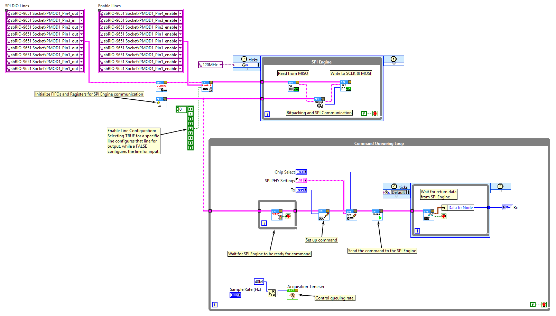
PART B-2 – Modify the SPI Code
When finished, the code should match the image to the left.

Slide 16
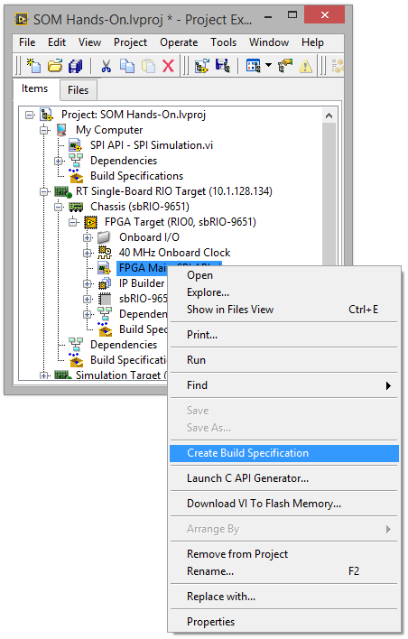
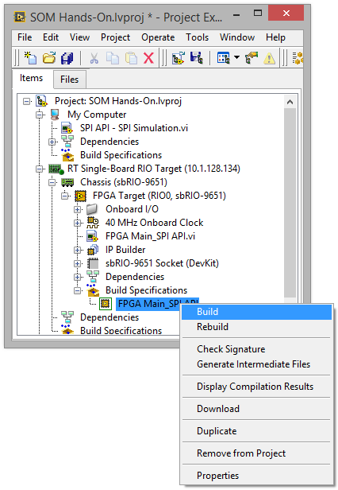
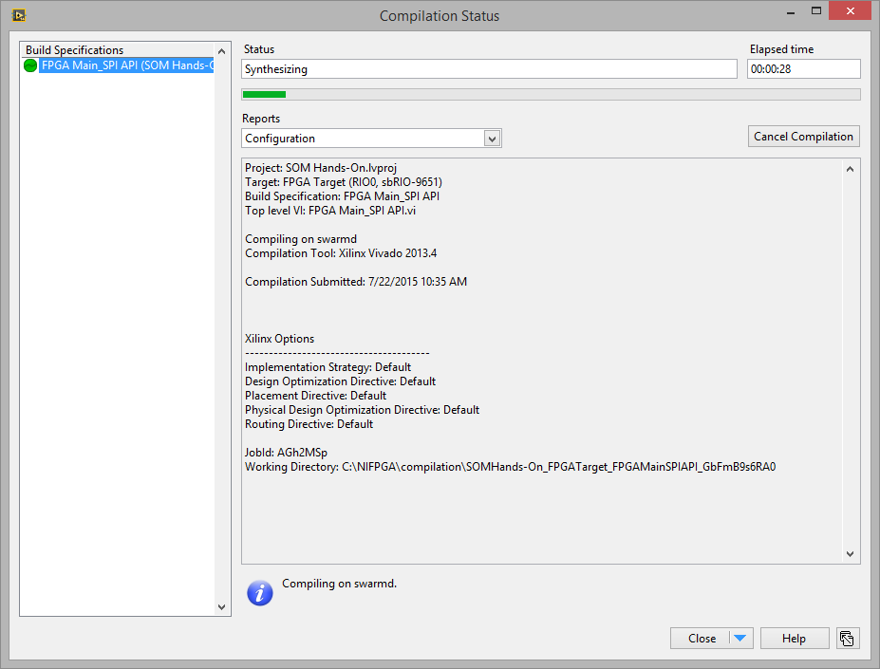
PART B-2 – Modify the SPI Code
At this point, the code is ready to compile. Return to the project, right-click on the FPGA VI and select Create Build Specification.
Under Build Specifications, the build spec for the FPGA VI will appear. Right-click the build spec and select Build.
Leave the default Compile Server option selected and press OK.
LabVIEW will begin translating the FPGA VI and transfer it over to the Xilinx Compile Tools to build the FPGA bitfile. You can minimize the Compilation Status window once the compilation begins.

Slide 17
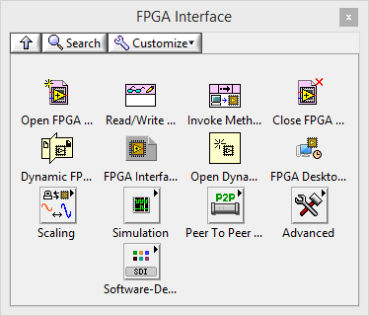
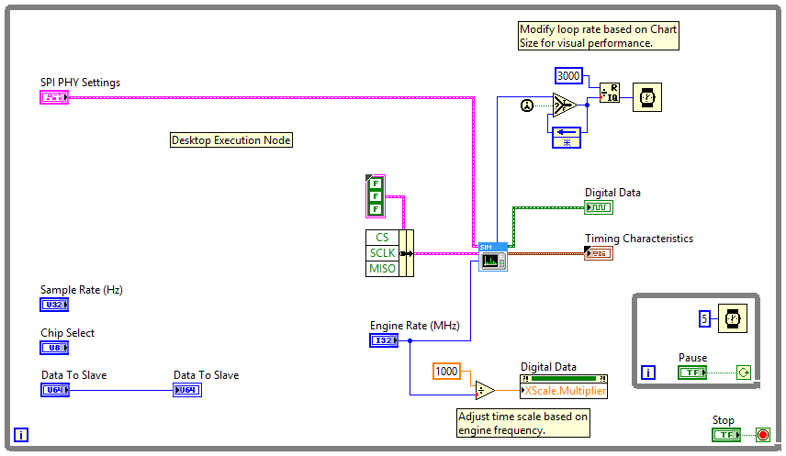

PART C – Simulation
While the FPGA VI is compiling in the background, open the SPI API – SPI Simulation.vi located underneath My Computer.
Open the block diagram and view the code. For this portion of the exercise, the SPI code will be simulated and the behavior will be verified to ensure the message being sent to the ADC is formatted correctly.
Add a Desktop Execution Node from the Functions > FPGA Interface palette to the block diagram beneath the Desktop Execution Node note.

Slide 18
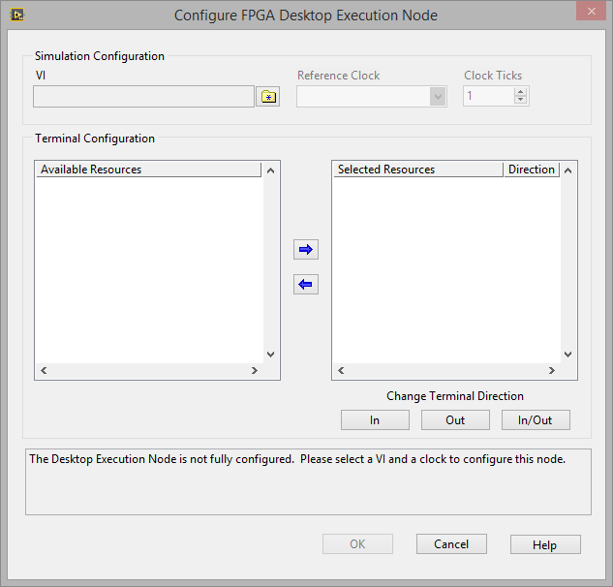
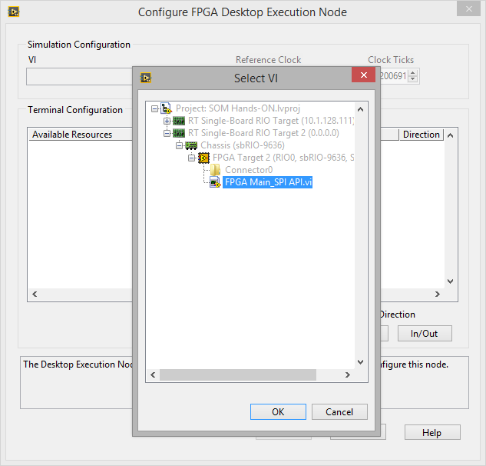
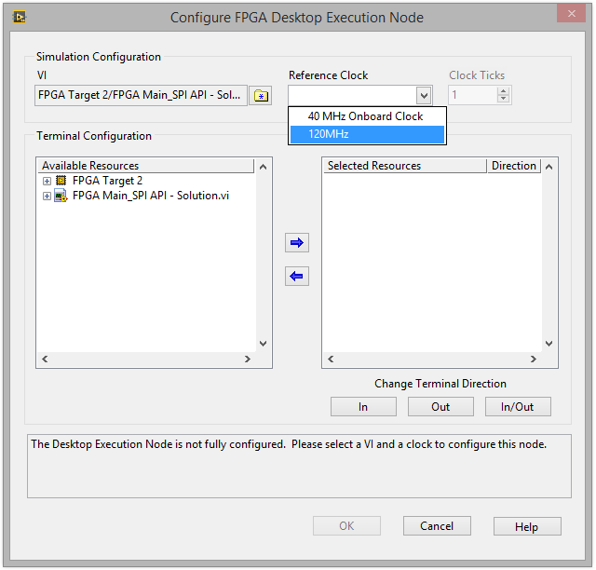
PART C – Simulation
In the window that appears, click the folder icon next to the VI entry textbox. This will pop up a small window showing the FPGA targets available in the LabVIEW project. For this exercise the simulation will be done with the second hardware target titled Simulation Target. Expand this target and select the VI titled FPGA Main_SPI API – Solution.vi.
Note: The SOM currently cannot be simulated in LabVIEW 2014, but support will be available in future releases. However, simulation with another sbRIO target will perform and behave the same, which is why the Simulation Target is present in the project.
To the right of the VI selection box are the Reference Clock and Clock Ticks fields. The Desktop Execution Node simulates the FPGA by moving time forward a set amount of clocks ticks (Clock Ticks field) of a specified clock (Reference Clock) each time a call to the node is made. For applications with lower frequency logic, larger amounts of time could be skipped between calls to increase the simulation speed. However, for simulating SPI communication, each tick of the SPI Engine clock needs to be simulated to correctly validate the engine’s logic.
Select 120MHz for the Reference Clock. This is the derived clock that was previously made to drive the SPI Engine.
Leave the Clock Ticks entry set at 1, signifying that the Desktop Execution Node should only move time forward one tick of the 120 MHz clock each time it is called.

Slide 19
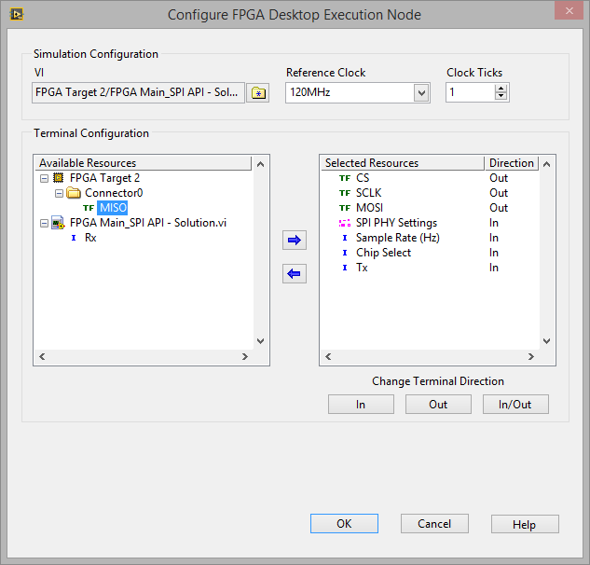
PART C – Simulation
In the Terminal Configuration section, select the inputs and outputs that the Desktop Execution Node should use to interact with the FPGA. Move the following items from the Available Resources window to the Selected Resources window by highlighting the item and clicking the Right Arrow:
CS, SCLK, and MOSI
SPI PHY Settings, Sample Rate (Hz), Chip Select, and Tx
Each resource selected has an associated direction: In, Out, or In/Out. By default, LabVIEW will automatically set FPGA controls as In and FPGA indicators as Out, but I/O items can be either and show up as In/Out. For resources that are inputs, highlight the item and select In. Similarly, items that are outputs of the FPGA need to be set as Out. Ensure the resources have the following directions:
CS: OUT
SCLK: OUT
MOSI: OUT
SPI PHY Settings: IN
Sample Rate (Hz): IN
Chip Select: IN
Tx: IN
Press OK to accept the changes.

Slide 20
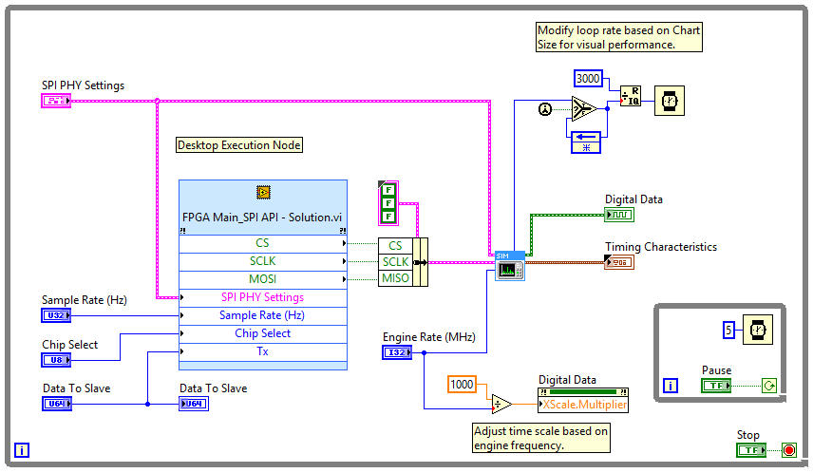
PART C – Simulation
Wire up the Desktop Execution Node as shown.
The Desktop Execution Node will simulated each cycle of the FPGA and provide the current state of CS, SCLK, and MOSI as outputs.
The remaining code formats and plots the data on a digital chart, and also makes period and frequency measurements on the data to validate the timing.

Slide 21
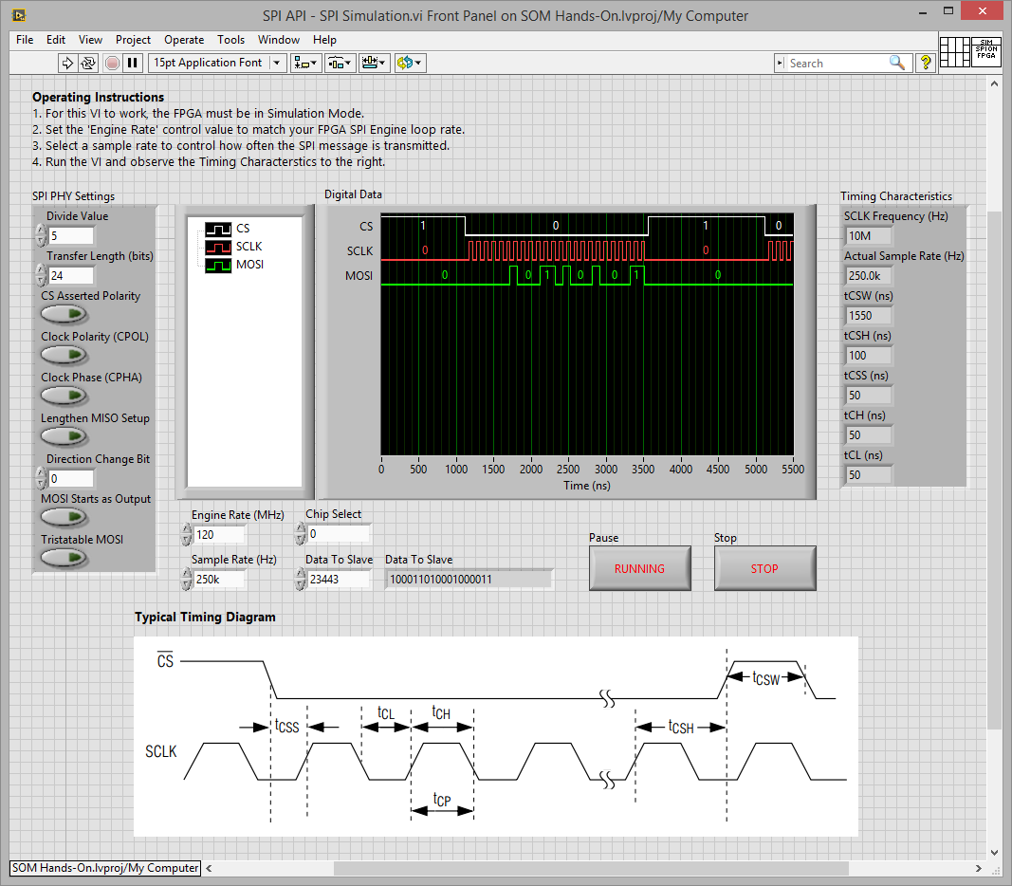
PART C – Simulation
Switch back to the front panel, and run the VI.
Ensure the Engine Rate (MHz) control has a value of 120, matching the clock chosen for the Desktop Execution Node. This ensures the Timing Characteristics are calculated correctly.
Modify the Sample Rate (Hz) control and observe how the FPGA responds.
Change the Divide Value and Transfer Length located in the SPI PHY Settings control and observe the change in the SPI message’s characteristics.
Change the SPI PHY Settings to match the requirements of the PmodMIC3
Transfer Length – The ADC is 12 bits, but the PmodMIC3 sends 4 leading zeros requiring a total length of 16 bits.
Divide Value – This parameter controls the frequency of SCLK. Higher divide values results in lower SCLK frequencies. The max SCLK the PmodMIC3 can handle is 20MHz, but SCLK can be much lower as long as it allows the requested sample rate to be met.
You can verify the sample rate using the Actual Sample Rate indicator shown in the Timing Characteristics.

Slide 22
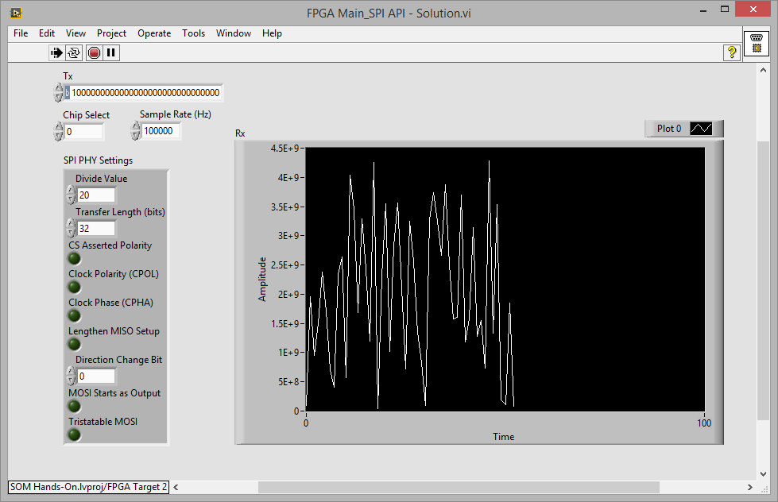
PART D – Run the FPGA
When the compilation started previously is finished, open the FPGA VI and run it interactively.
Change the SPI PHY Settings to the values used in the Simulation VI. Appropriate values for 100k sample rate:
Divide value – 10
Transfer Length – 16
Sample Rate – 100k
Chip Select – 0
Tx – Not used
Valid data should appear on the Rx chart. Make sounds near the PmodMIC3 to see if the chart reflects the change.

